Slide 1

Presented By:
Kutikuppala Likhita
Flight Data Analysis

Slide 2
About me
I am Kutikuppala Likhita, a recent graduate with a Bachelor of Technology in Electronics and Communication Engineering, from Andhra University College of Engineering.
Why Data Science?
I chose Data Science because it brings together problem-solving, computers, and smart decisions—three things I really enjoy. I like working with data to see patterns and use them to solve everyday problems. It is a growing field with a lot to learn, new ideas to try, and chances to make a big impact in different areas.

Slide 3
Flight Dataset Analysis
To analyze how flight performance varies by airline, origin, destination, time, and delay patterns.
The dataset helps understand viewership trends, content strategies, and global entertainment patterns.
The dataset contains 3,00,000 rows and 19 columns.
It includes 14 numerical columns and 5 categorical columns such as origin, dest, cast.
Key Features Include: dep_time, arr_time, dep_delay, arr_delay, carrier, origin, dest, air_time, distance, and time_hour.
Several columns contain missing values (e.g., dep_delay, arr_delay, arr_time) that need imputation or careful handling.
Useful for tasks like recommendation systems, trend analysis, and content categorization.

Slide 4
Understanding the Columns
year – Year in which the flight took place
month – Month of the flight departure
day – Day of the month for the flight
dep_time – Actual departure time of the flight
sched_dep_time – Scheduled departure time
dep_delay – Difference (in minutes) between scheduled and actual departure time
arr_time – Actual arrival time of the flight
sched_arr_time – Scheduled arrival time
arr_delay – Difference (in minutes) between scheduled and actual arrival time
carrier – Airline carrier code (e.g., AA, DL, UA)
flight – Flight number assigned by the airline
tailnum – Aircraft registration number
origin – Departure airport code
dest – Destination airport code
air_time – Total flight time in minutes
distance – Distance between origin and destination (in miles)
hour – Hour extracted from the scheduled departure time
minute – Minute extracted from the scheduled departure time
time_hour – Date and hour (timestamp) of the flight event
Month – Month number (used for grouping or analysis)
DayOfWeek – Day of the week (1 = Monday, 7 = Sunday)

Slide 5
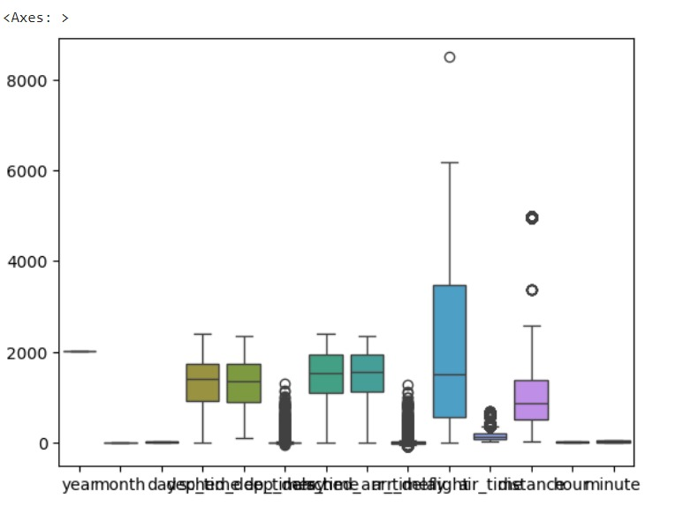
Detecting Outliers
Outliers are data points in the Flight dataset that deviate significantly from other records and may affect analysis quality.
  In Flight data, outliers may occur in dep_delay (e.g., extreme negative or very large delay values due to data entry or cancellation anomalies).Unusual duration values (e.g., extremely high minutes or mismatched formats) act as outliers.
  Unusual arr_delay values (e.g., excessively high arrival delays or early arrivals beyond reasonable limits) also act as outliers..
  Outliers can appear in distance when incorrect routing or data recording results in unrealistic flight distances.

Slide 6
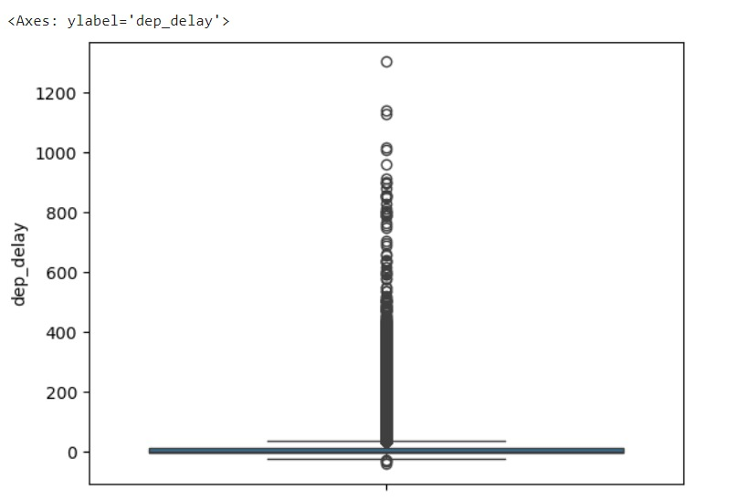
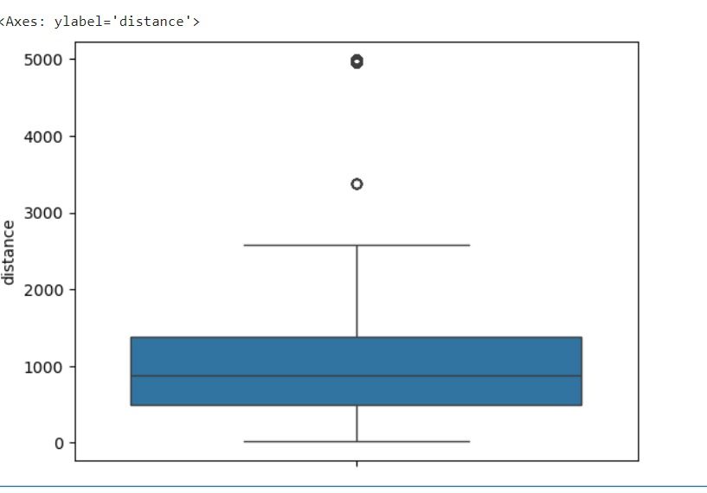
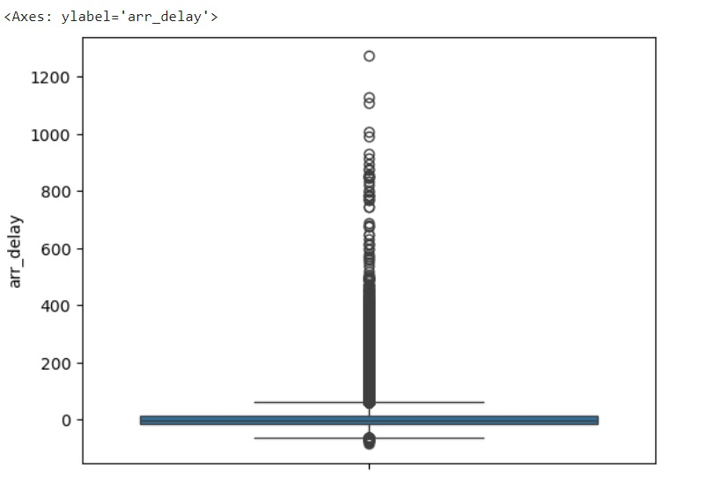
Detecting Outliers
Outliers in dep_delay
Outliers in distance
Outliers in arr_delay

Slide 7
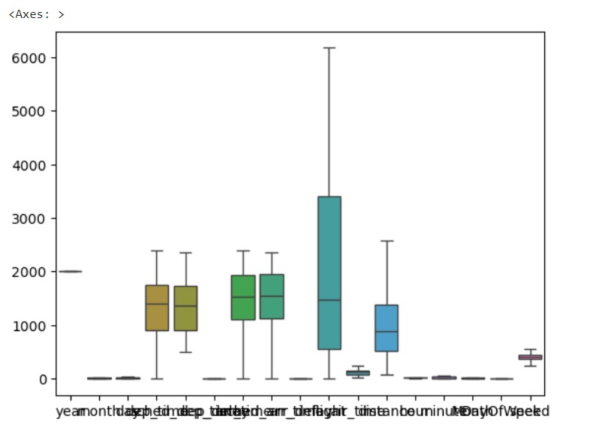
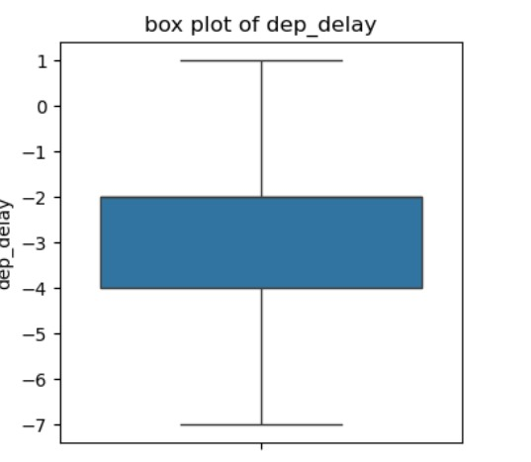
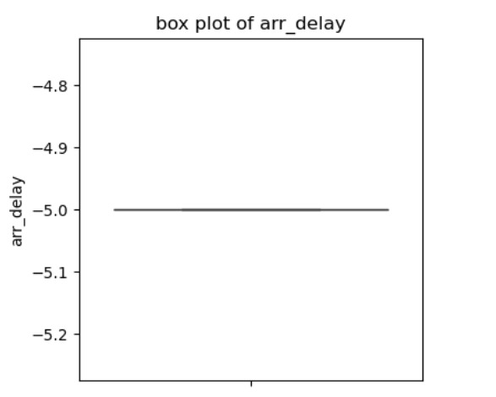
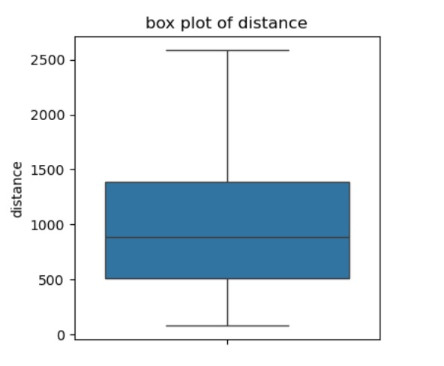
After handling outliers

Slide 8
Handling Missing Data
Missing data in the Flight dataset occurs mainly in time and delay-related columns due to cancelled or incomplete flight records
Columns with missing values: dep_time (8,255), dep_delay (8,255), arr_time (8,713), arr_delay (9,430), air_time (9,430),tailnum (2,512)
Retained missing rows for cancelled flights to preserve real-world data distribution.
Filled some dep_delay and arr_delay values with 0, assuming no delay when not provided.
Handling Duplicates:
Duplicates are repeated records in the dataset that can inflate counts and bias analysis.
Used d.duplicated().sum() to detect exact duplicate rows..
Ensures dataset remains clean without redundancy.

Slide 9
Fixing Inconsistencies in Categorical Data:
Inconsistencies occur when the same category is represented in multiple forms due to formatting differences.
Standardized categorical fields like carrier, origin, and destination to remove variations.
Cleaned extra spaces, capitalization issues, and irregular values for consistency.
Data Type Conversion:
Data type conversion ensures columns are stored in the correct format for accurate analysis.
Converted time_hour and arr_time columns to datetime format to enable time-based trend analysis
Verified that dep_delay and arr_delay columns are in numeric format for accurate statistical and correlation analysis.
.

Slide 10
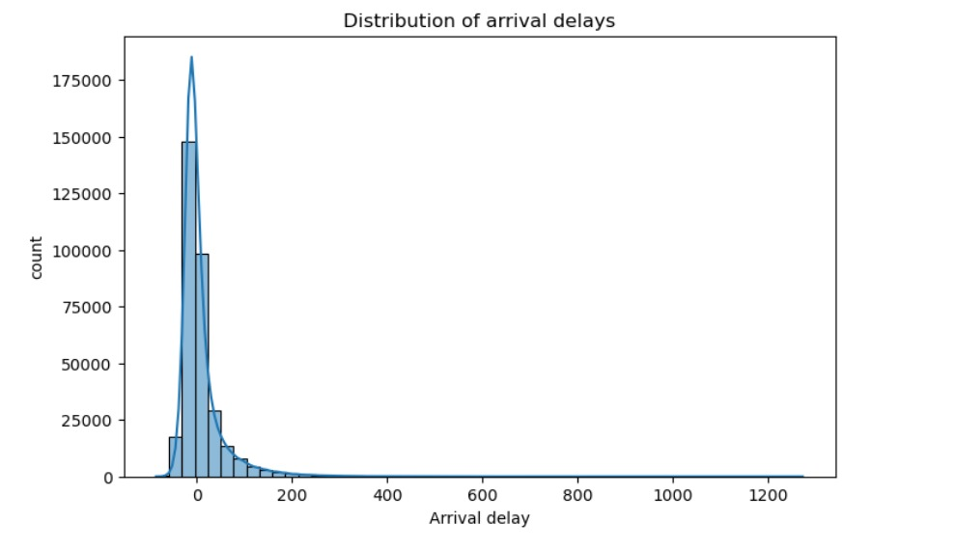
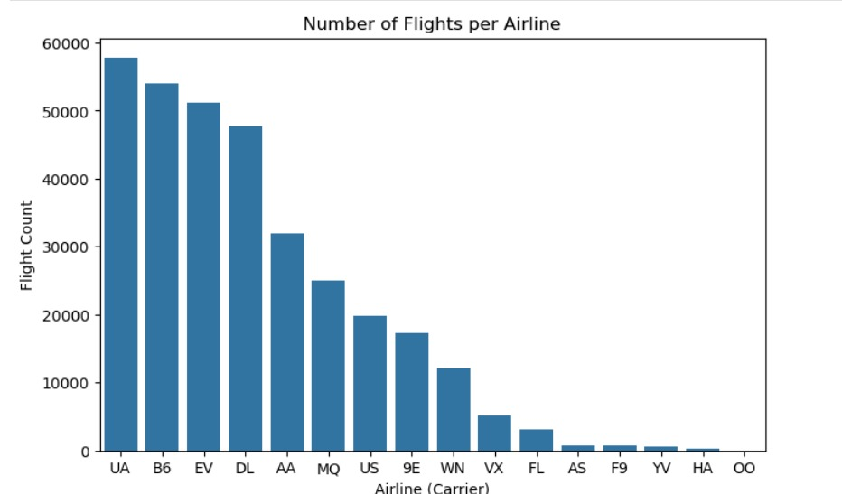
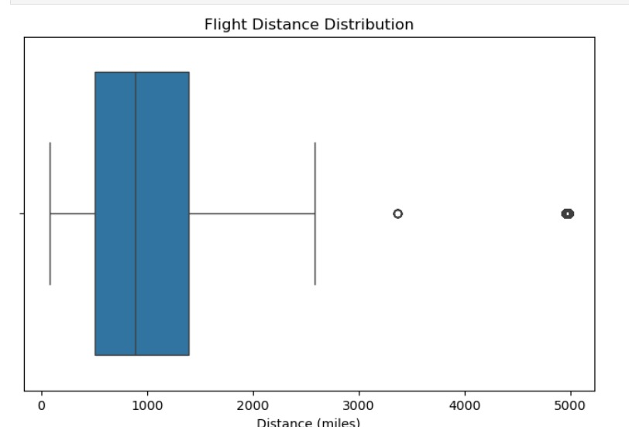
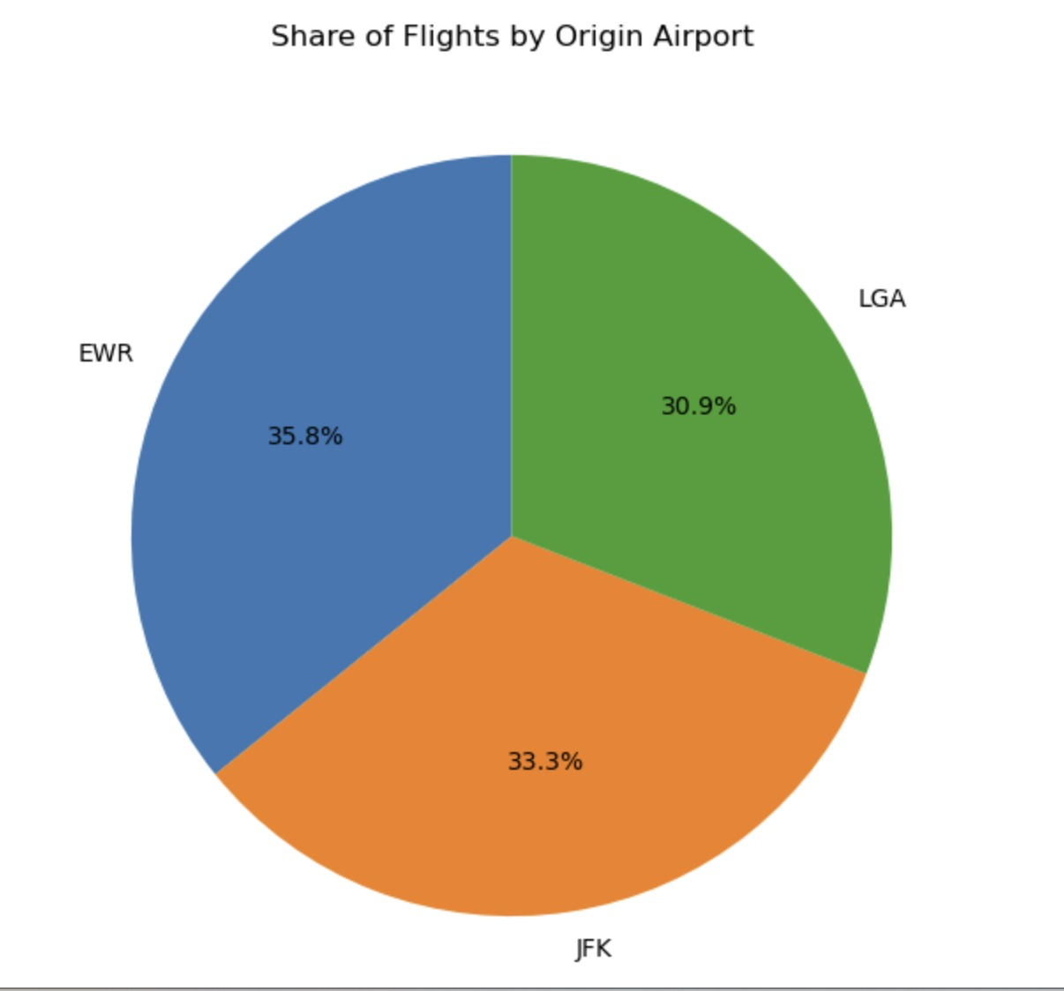
Univariate Analysis
Univariate analysis examines a single variable at a time to understand its distribution and frequency.
Distribution of arrival delays
Most frequent airlines
Share of flights by origin airport
Flight distance distribution

Slide 11
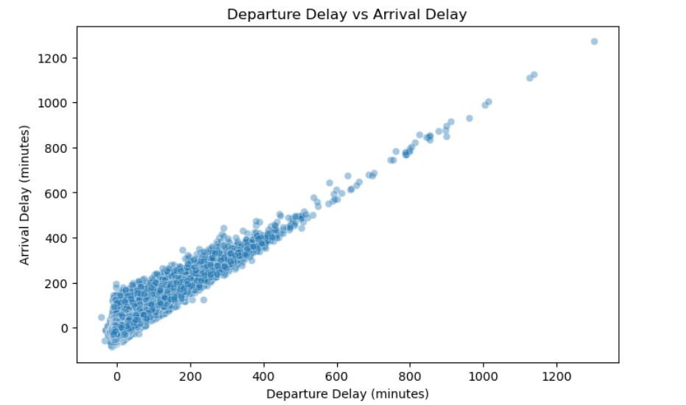
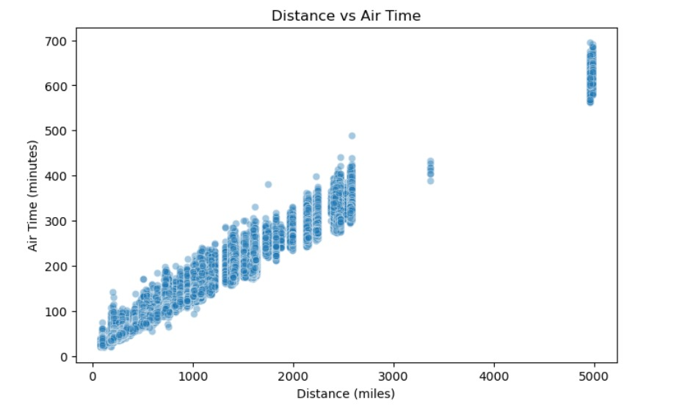
Bivariate Analysis
Bivariate analysis studies the relationship between two variables to identify associations, trends, or dependencies.
1. Numerical vs Numerical:
Distance vs Air Time.--
Departure Delay vs Arrival Delay
Insights:
Strong linear relationship-longest flights take more time
Flights leaving late usually arrive late too

Slide 12
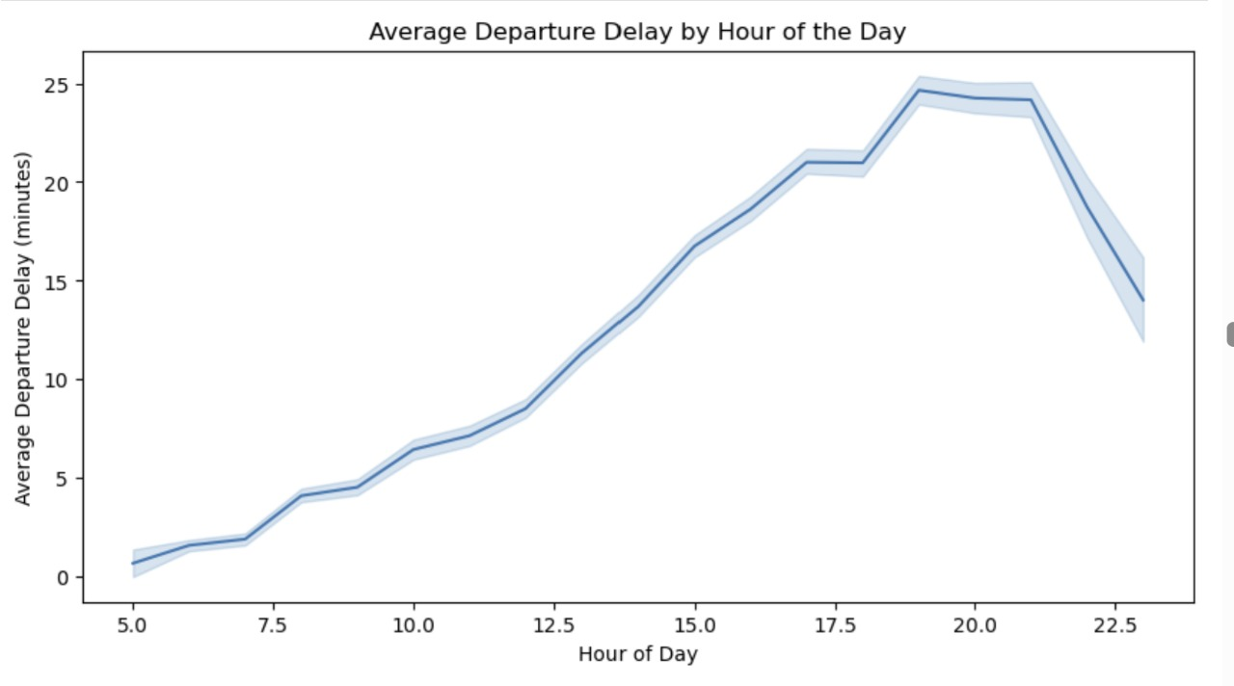
Average Departure Delay by Hour of the Day
Insights:
Early morning flights are usually on time
Delays increase toward evening

Slide 13
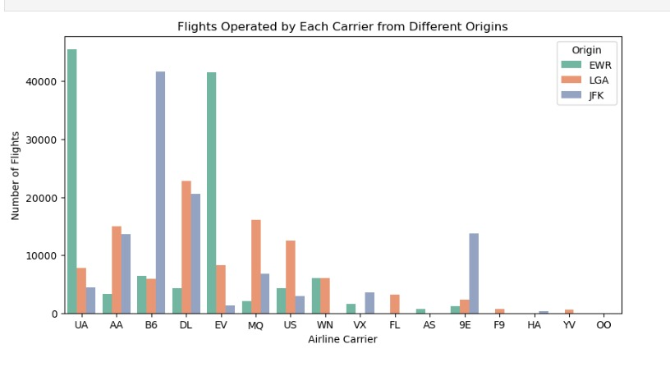
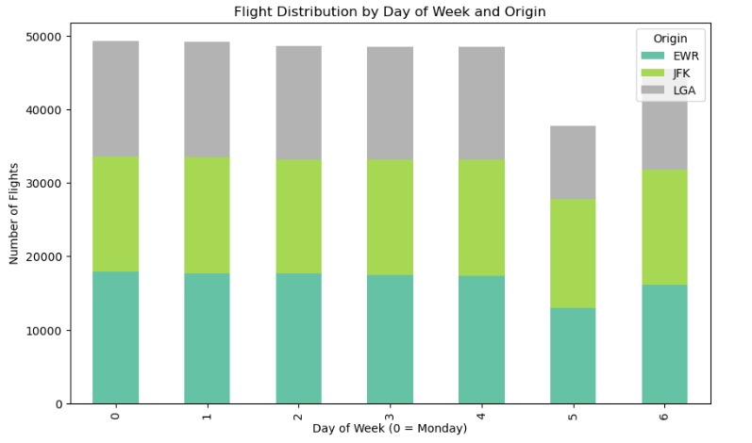
2. Categorical vs Categorical
Flights operated by each carrier from different origins
Flights distribution by DayOfWeek and Origin
Count plot
Crosstab
Insights
Major carriers like UA, B6, and DL dominate specific origin airports, showing strong hub-based operations
Flight counts from all three origins are steady during weekdays but drop sharply on Saturday, showing lower weekend demand across EWR, JFK, and LGA.

Slide 14
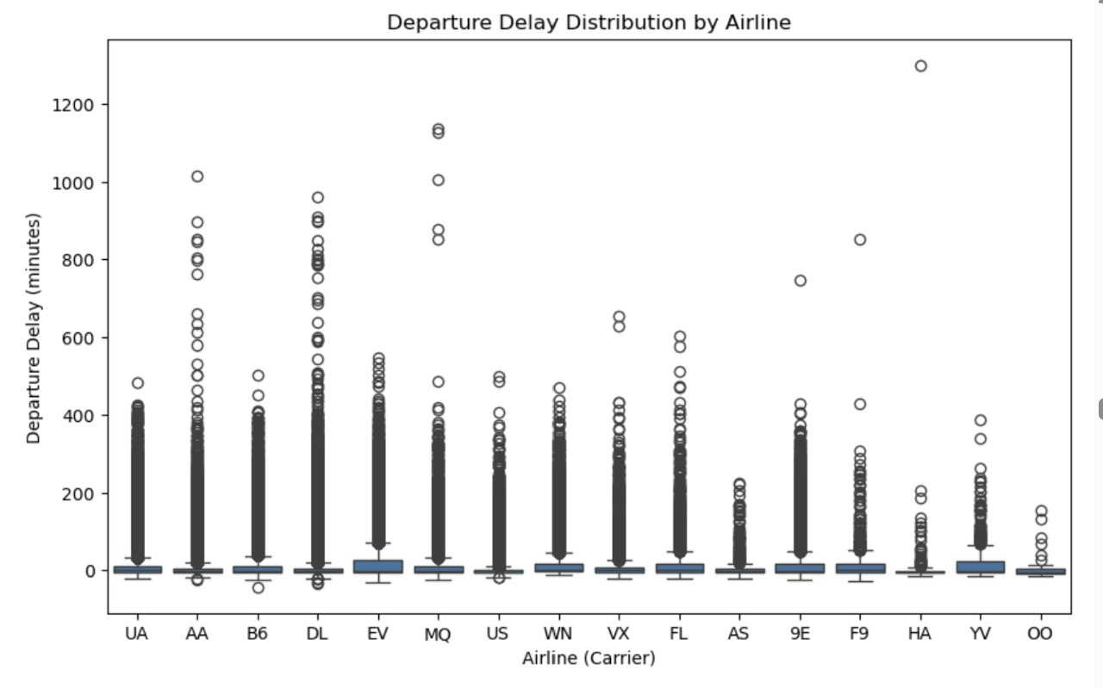
3. Numerical vs Categorical:
Departure Delay by Airline
Numbr off Flights by Airline
Insights:
UA airlines operates the most flights

Slide 15
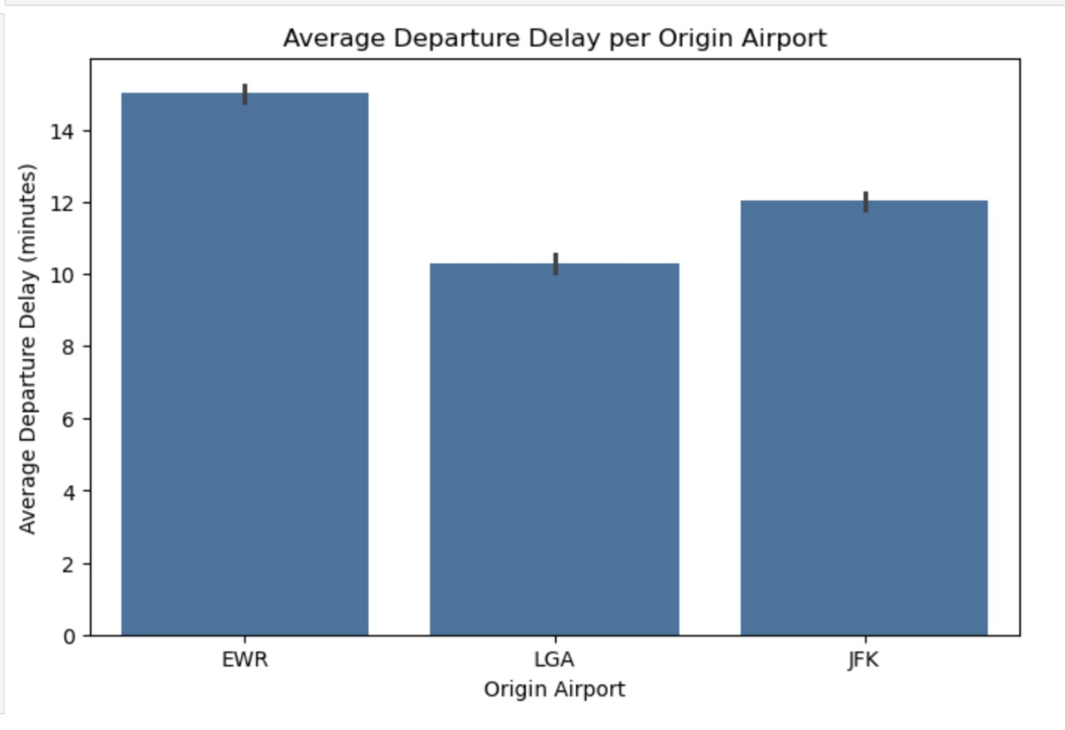
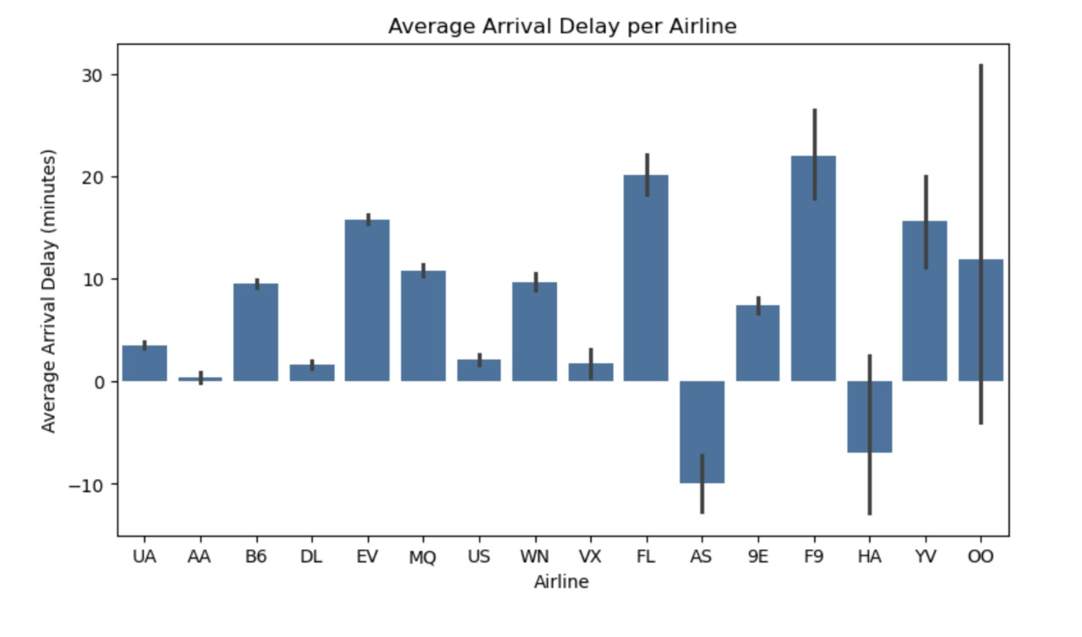
Numerical vs Categorical
Origin vs Average Departure Delay
Airline vs Average Arrival Delay
Insights:
Reveals which airport is more delay-prone.
Indentifies which airlines are more punctual or prone to delays

Slide 16
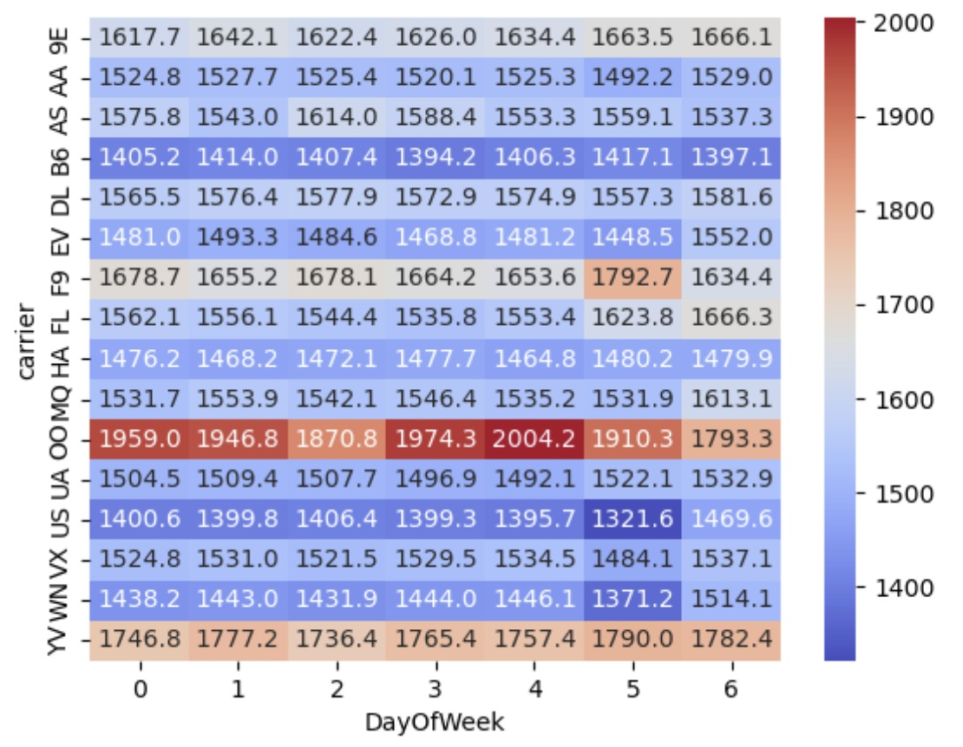
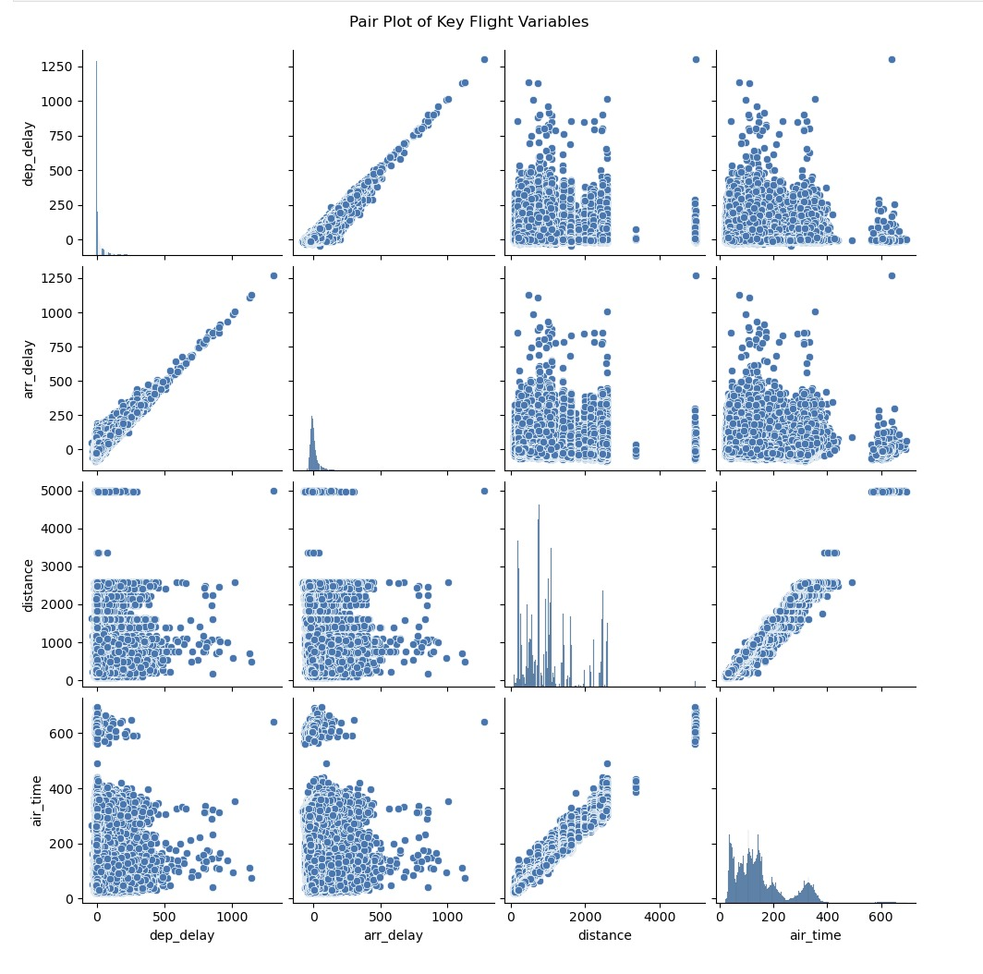
Multivariate Analysis
Multivariate analysis explores relationships among three or more variables simultaneously.
Relationship among key Numeric Variables.
Airline vs DayOfWeek.
Insights:
Strong linear pattern between distance and airtime and between dep_delay and arr_delay.
The highest values (shown in deep red) occur towards the middle to end of the week (e.g., Day 4 and Day 5), suggesting certain days consistently experience later average arrivals, likely due to operational congestion or scheduling patterns.

Slide 17
Insights
United Airlines (UA) operates the highest number of flights, primarily from EWR, showing it as the main operational hub.
Evening flights tend to have higher delays compared to morning flights.
Midweek days show consistent flight activity, while weekends drop slightly.
Distance and air time are strongly correlated — longer flights take proportionally more time.
Departure delays and arrival delays are closely linked — showing how small scheduling issues can ripple through the system.”

Slide 18
Conclusion
To conclude, the flight dataset reflects real-world airline patterns —
Certain months and days see heavier traffic, major hubs handle most flights, and delays are influenced more by airport congestion and timing rather than route distance.

Slide 19
Future Scope:
Looking forward, this analysis could be extended to build predictive or interactive tools:
A Flight Delay Prediction Model using airline, route, and time factors.
A Route Optimization Tool to reduce fuel and delay times
A Performance Dashboard for real-time airline monitoring
Or even a Passenger Demand Forecasting Model for better planning

Slide 20

THANK YOU

